Slide 1

Project Title - Seasonal Agriculture Performance
Student Name : Barkha Vaibhavkishor Lodh
College Name : Guru Nanak Khalsa College of Arts, Science & Commerce (Autonomous)
AICTE STU ID : STU6a6c5319c72ac1785484057

Slide 2

PROBLEM STATEMENT
Agricultural performance varies across different seasons due to changes in rainfall, temperature, soil conditions, irrigation, fertilizer usage, and disease/pest risk.
Raw agricultural data does not clearly reveal how these factors influence crop yield, production, resource usage, revenue, and profit.
Therefore, there is a need to analyze the data to identify seasonal patterns, relationships, variations, and differences in agricultural performance.
The project aims to provide data-driven insights for better seasonal agricultural planning and decision-making.

Slide 3
Data Exploration & Cleaning — Understand and prepare the dataset.
Univariate Analysis — Analyze individual agricultural variables.
Bivariate Analysis — Study relationships such as Rainfall vs Yield and Farm Area vs Production.
Multivariate Analysis — Examine multiple agricultural factors together.
Seasonal Comparison — Compare yield, production, revenue, cost, profit, and resource usage across seasons.
Statistical Analysis — Identify significant differences and relationships.
Visualization — Use charts, scatterplots, boxplots, and heatmaps to identify patterns.
Insights & Recommendations — Provide evidence-based suggestions for agricultural planning.
Project Description
Seasonal Agricultural Performance
This project analyzes agricultural data to understand how farming performance changes across different seasons.

Slide 4

WHO ARE THE END USERS?
Farmers
Select suitable crops and seasons.
Improve water, fertilizer, and resource utilization.
Understand factors affecting yield and profitability.
Government & Agricultural Departments
Support agricultural policies and seasonal planning.
Improve resource allocation.
Identify areas requiring additional support.
Agricultural Researchers
Study seasonal patterns and crop performance.
Analyze relationships between environmental conditions and yield.

Slide 5

Technology Used
  Python : Programming and data analysis
  Google Colab : Development and execution platform
  Pandas : Data cleaning and manipulation
  NumPy : Numerical calculations
  Matplotlib : Data visualization
  Seaborn : Statistical visualization
  CSV : Dataset

Slide 6
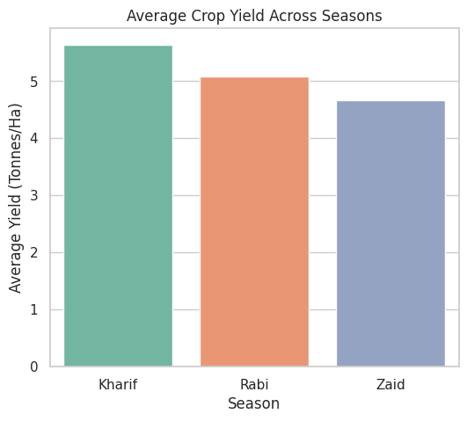
RESULTS

Slide 7
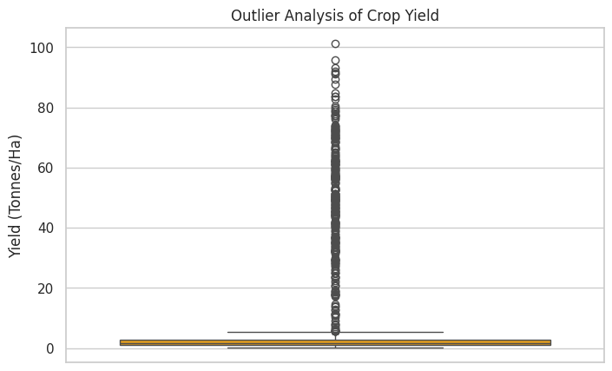
RESULTS
[Add screen shots of your code ]

Slide 8
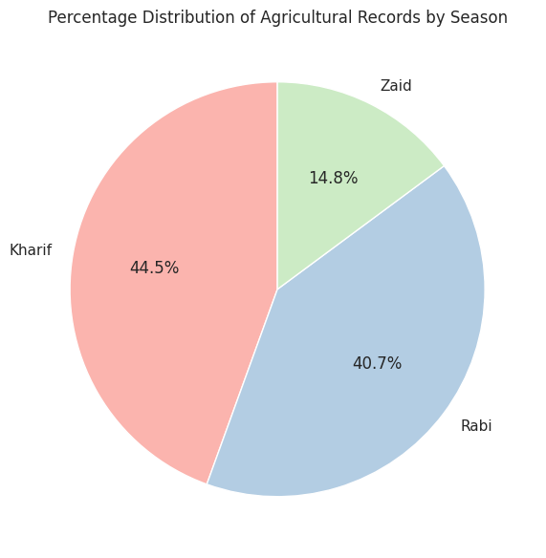
RESULTS

Slide 9
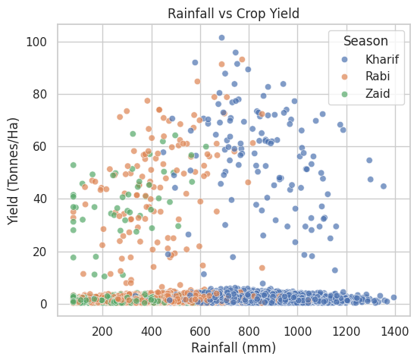
RESULTS

Slide 10
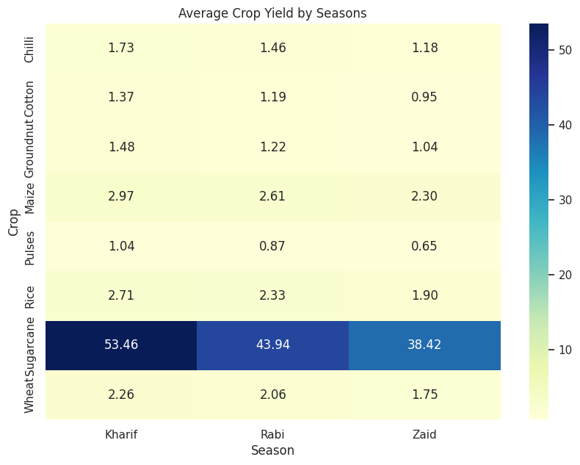
RESULTS
[Add screen shots of your code ]

Slide 11
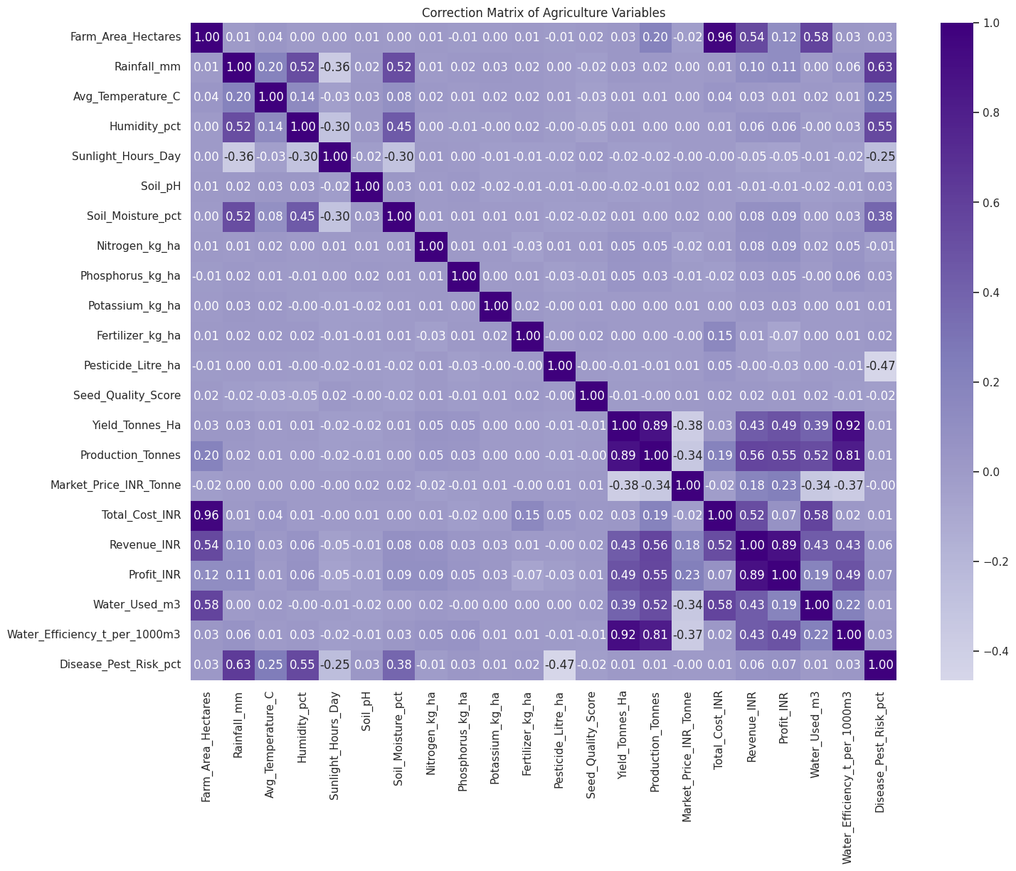
RESULTS
[Add screen shots of your code ]

Slide 12
Future scope
Machine Learning — Predict crop yield and profitability.
Weather Integration — Use real-time weather and forecast data.
Crop Recommendation — Recommend suitable crops based on season, soil, and climate.
Smart Irrigation — Predict water requirements and optimize irrigation.
Disease Prediction — Predict crop disease and pest risks.
Interactive Dashboard — Develop dashboards using Power BI, Tableau, or streamlit.
IoT Integration — Use sensors for real-time soil moisture, temperature, and environmental monitoring

Slide 13
GitHub Link
https://github.com/Barkha-Lodh/Seasonal-Agriculture-Performance-Analysis

Slide 14

VOIS Course completion certificate -
Course name- Data Visualization

Slide 15
Thank you
.
.

